Slide 1
GeneratorHelpOnline.Com by
Paul Harris
June 11 and 12
Login: leadingage
Password: kansas#2025

Slide 2
PART II – HEALTH CARE FACILITIES CODE REQUIREMENTS
K918
Electrical Systems – Essential Electric System Maintenance and Testing
Commentary by Paul Harris

Slide 3
Residents have to be kept safe no matter how long the power is out:
Lighting all the way out to the public way
Food service
Heating and cooling
Lighting
Communications
Fire suppression systems

Slide 4
HOLLYWOOD, Fla. (AP) — Eight patients at a sweltering nursing home died after Hurricane Irma knocked out the air conditioning, raising fears Wednesday about the safety of Florida’s 4 million senior citizens amid power outages that could last for days.
Altogether, more than 100 patients there were found to be suffering in the heat and were evacuated, many on stretchers or in wheelchairs. Patients were treated for dehydration, breathing difficulties and other heat-related ills, authorities said.

Slide 5
Expected power failures in Kansas
Weather
Ice storms
Windstorms
Tornados
Snow

Slide 6

2011, Joplin, MO
158 people died

Slide 7
Unexpected power failures:
Grid overload
Transformer failure
Accident
Cyberattack
Sabotage

Slide 8
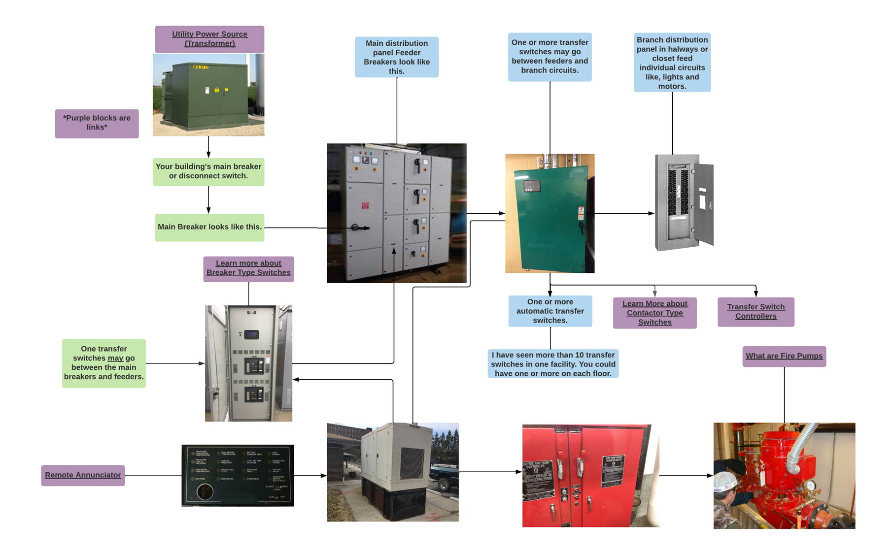
The system

Slide 9
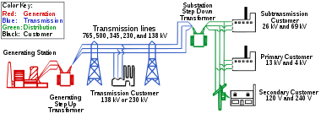

Slide 10
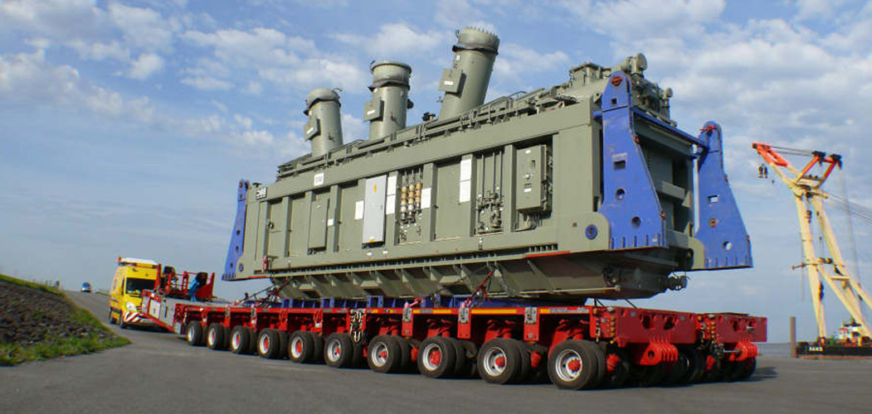

Slide 11
Inspection and Testing
NFPA 110, 2010 edition, chapter 8
Weekly Inspection
Monthly Testing
4-hr test every 36 months

Slide 12
Go to: generatorhelponline.com
Login: leadingage
Password: Kansas#2025
Scroll down to: Generator Inspection Checklist
Click on: DOWNLOAD INTERACTIVE CHICKLIST DIRECTLY

Slide 13
Go to: generatorhelponline.com
Login: leadingage
Password: Kansas#2025
PART II – HEALTH CARE FACILITIES CODE REQUIREMENTS
K918
Electrical Systems – Essential Electric System Maintenance and Testing

Slide 14
Electrical Systems – Essential Electric System Maintenance and Testing The generator or other alternate power source and associated equipment is capable of supplying service within 10 seconds. If the 10-second criterion is not met during the monthly test, a process shall be provided to annually confirm this capability for the life safety and critical branches. Maintenance and testing of the generator and transfer switches are performed in accordance with NFPA 110. Generator sets are inspected weekly, exercised under load 30 minutes 12 times a year in 20-40 day intervals, and exercised once every 36 months for 4 continuous hours. Scheduled test under load conditions include a complete simulated cold start and automatic or manual transfer of all EES loads, and are conducted by competent personnel. Maintenance and testing of stored energy power sources (Type 3 EES) are in accordance with NFPA 111. Main and feeder circuit breakers are inspected annually, and a program for periodically exercising the components is established according to manufacturer requirements. Written records of maintenance and testing are maintained and readily available. EES electrical panels and circuits are marked, readily identifiable, and separate from normal power circuits. Minimizing the possibility of damage of the emergency power source is a design consideration for new installations. 6.4.4, 6.5.4, 6.6.4 (NFPA 99), NFPA 110, NFPA 111, 700.10 (NFPA 70

Slide 15
The 4-hour load test
The 4-hour load test required every 36 months is not a loadbank test .
Many service companies substitute a loadbank test for the required loadtest. These are completely different tests.
The loadtest outlined in 8.4.9 requires all transfer switches be transferred. This not only tests the generator but the transfer switches, circuit breakers, and emergency distribution as well.
A loadbank test only tests the generator.
Don’t be fooled by a vendors’ hesitancy to conduct a proper load test.
See my video: Every Third Year Generator Operational Inspection & Training
“Scheduled test under load conditions include a complete simulated cold start and automatic or manual transfer of all EES loads; and are conducted by competent personnel.”
Make sure your vendor is competent.

Slide 16
4-hour load test per NFPA 110, chapter 8.4.9, 2010 edition
Every 3-years
You do not need to turn the power off to the building!
Diesel Generators
Connect the loadbank to the system leaving the building load connected.
Start the EPS using a transfer switch then transfer all transfer switches to the generator.
Add supplemental load to 30%. Run the EPS for 3 hours at a minimum of 30% load.
Add load to 75% minimum for the final hour.
It is OK if the building load exceeds the above load up to 100% of the EPS nameplate rating.
Gas Generators
Start the EPS using a transfer switch then transfer all transfer switches to the generator. No loadbank is required. Available load is all that is needed.

Slide 17
Diesel Generators
Connect the loadbank to the system leaving the building load connected.
Technician’s initials_____________
Start the EPS using at least one transfer switch then transfer all transfer switches to the generator. The generator company must locate and identify all transfer switches, both automatic and manual.
Technician’s initials_____________ Time to transfer from start _______ seconds
Add supplemental load to 30% of the nameplate rating. Run the EPS for 3 hours at a minimum of 30% load.
Technician’s initials_____________
Increase load to 75% minimum for the final hour.
Technician’s initials_____________
It is OK if the building load exceeds the above load up to 100% of the EPS nameplate rating.

Slide 18
Gas Generators (Natural gas or LPG)
Start the EPS using a transfer switch then transfer all transfer switches to the generator. No loadbank is required. Available load is all that is needed. Run the system for 4 hours and take readings every 15 minutes.

Slide 19
Disconnect battery charger before taking the battery out.
  Many battery chargers put out a high or A/C voltage when the battery is disconnected. This can destroy the generator controller resulting in an expensive repair.

Slide 20
Replace battery 24-30 months. A.5.6.4.5.1
  A lead-acid is a packaged chemical reaction. It is delicate. Like all chemical reactions It slows down when the temperature drops. It speeds up when the temperature rises.
  Always buy the freshest and heaviest battery.

Slide 21
Check battery charger when the generator fails to start.
  I have found that when the battery charger trips a breaker and the battery goes low the controller may not send a signal to the remote annunciator. Rather it may display a false alarm like “Overspeed”.
  Even if you correct the problem by resetting the breaker, the charger may not charge the battery because some chargers will not charge if the threshold voltage drops below a set point.

Slide 22
2. Service the automatic transfer switch annually
Does your provider service the ATS annually? NFPA 110, 8.3.5, and A.8.3.5 (Outlines procedure)
  Inspect contacts for overheating and erosion
  Clean contacts
    Replace contacts when necessary

Slide 23
Automatic Transfer Switches
Onan
Generac
Zenith
Asco
Thompson
Kohler
The automatic transfer switch constantly monitors the utility power. In the event of utility failure, it sends a signal to the generator to tell the generator control panel to initiate the start sequence. Once alternate electrical power is available, it transfers the alternate power to the load.
Batteries

Slide 24
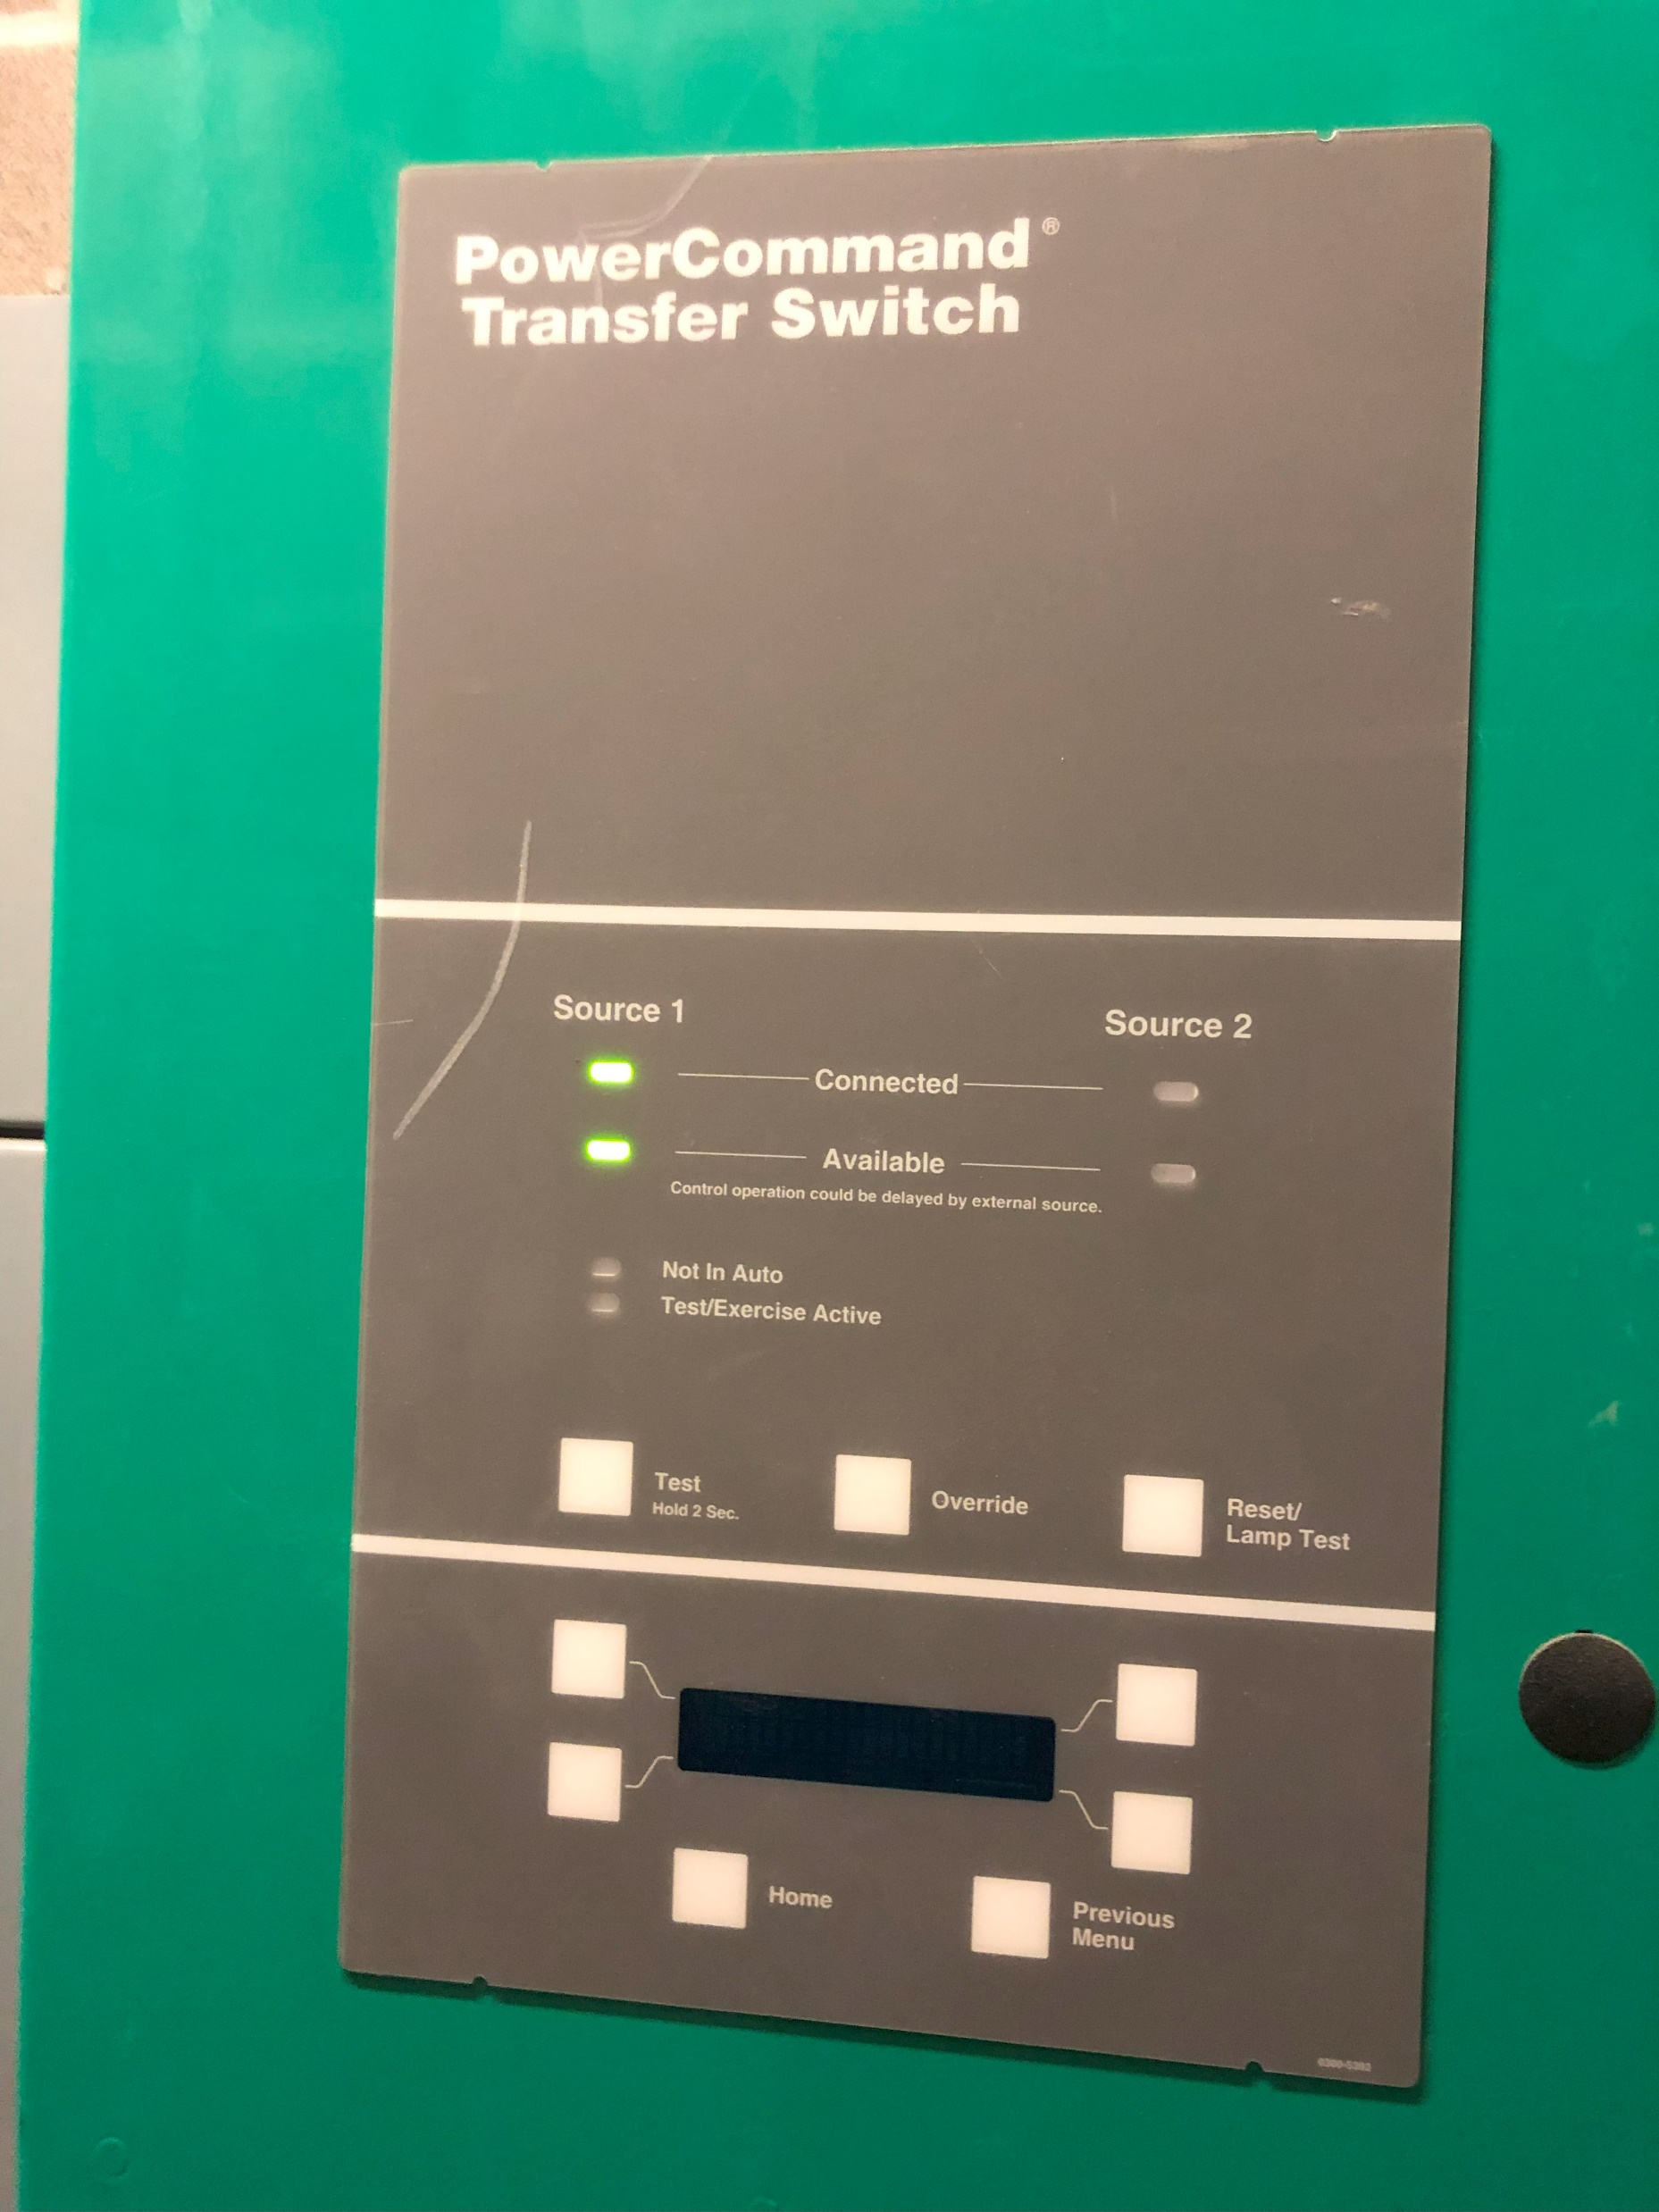
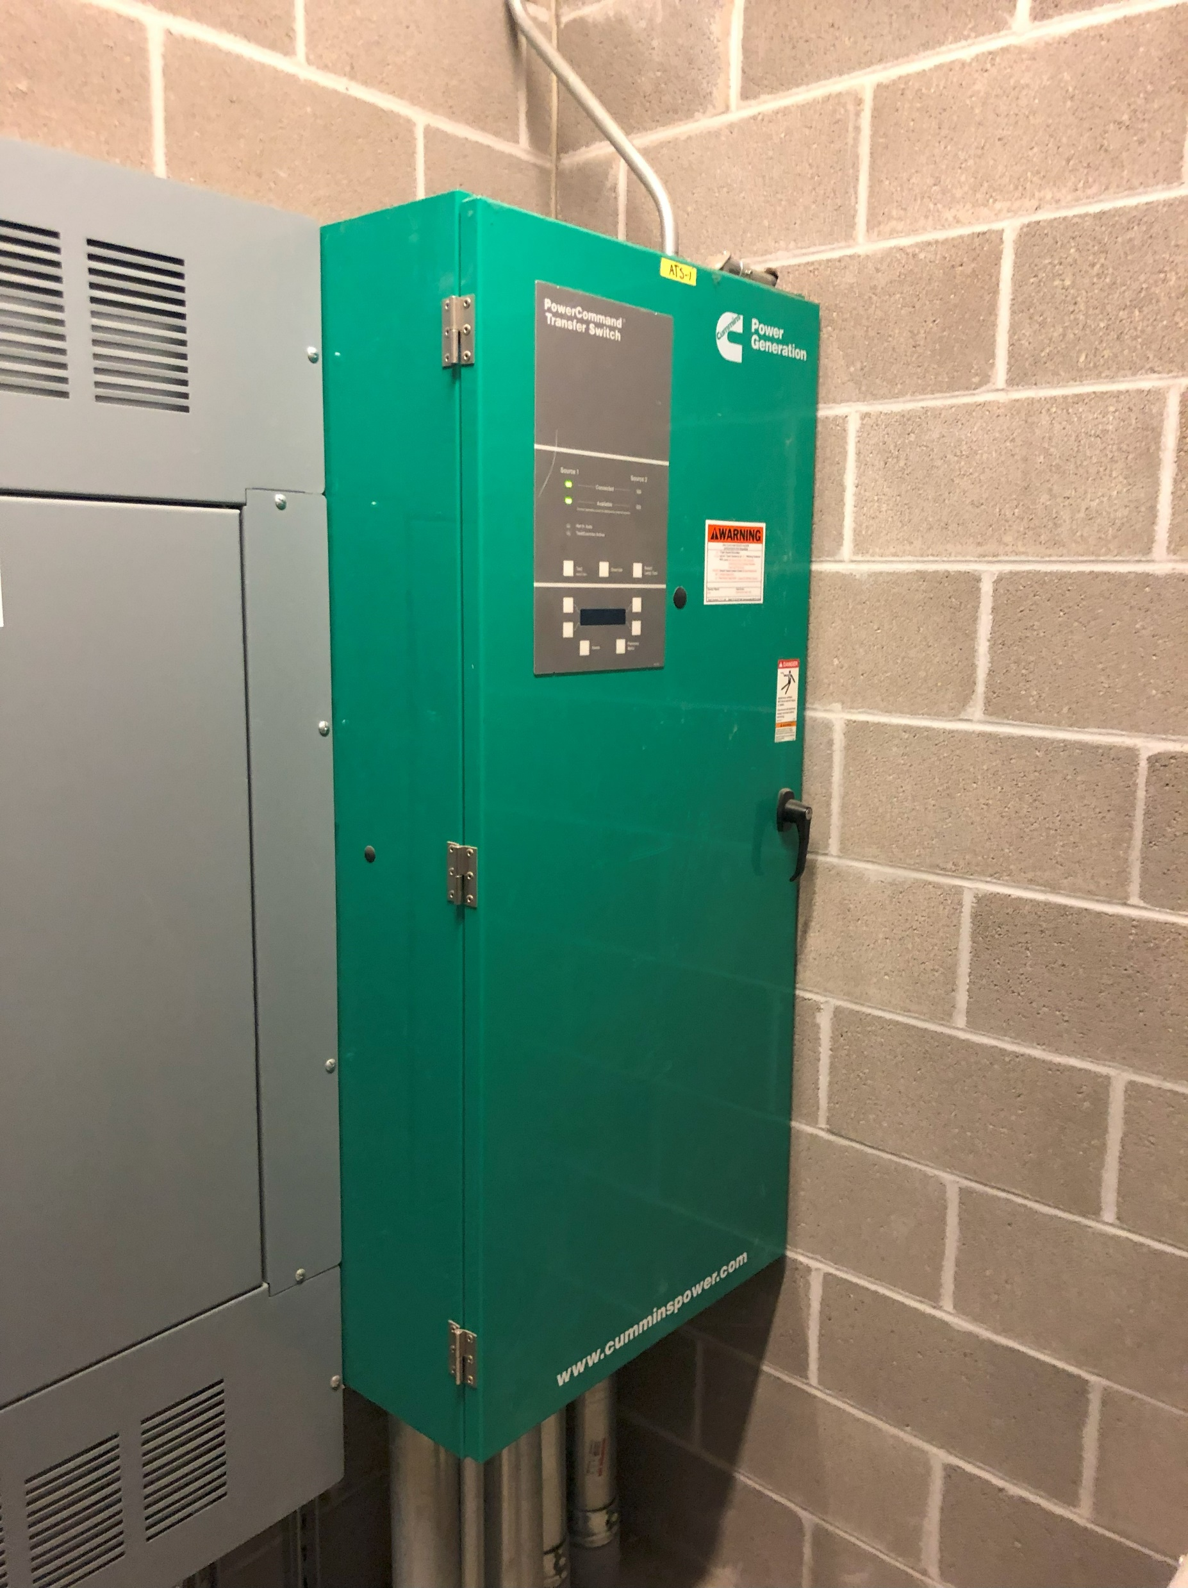

Slide 25
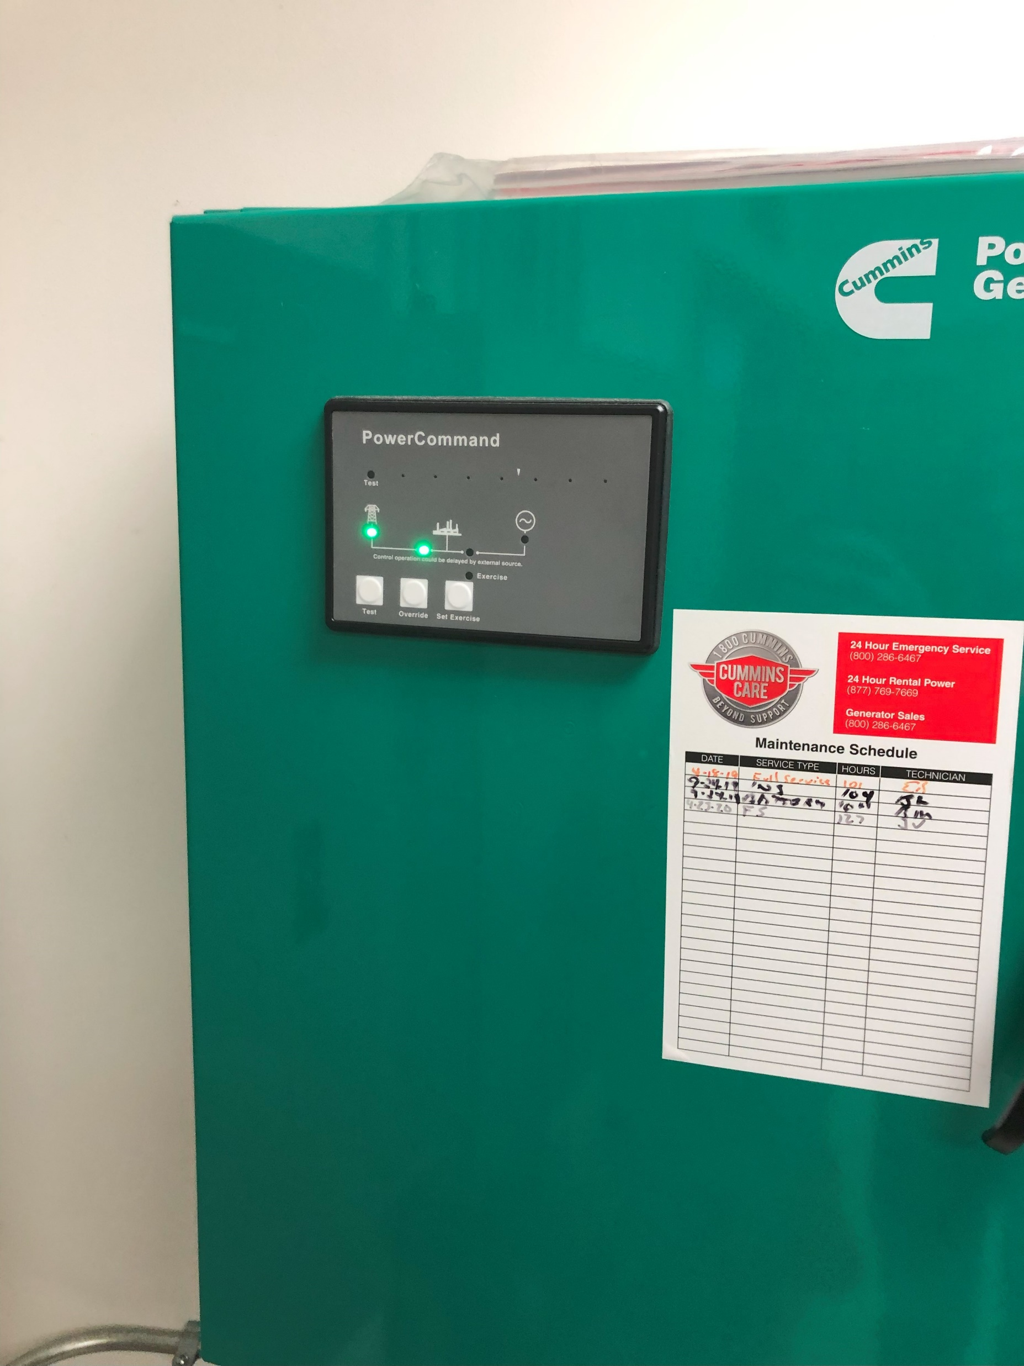
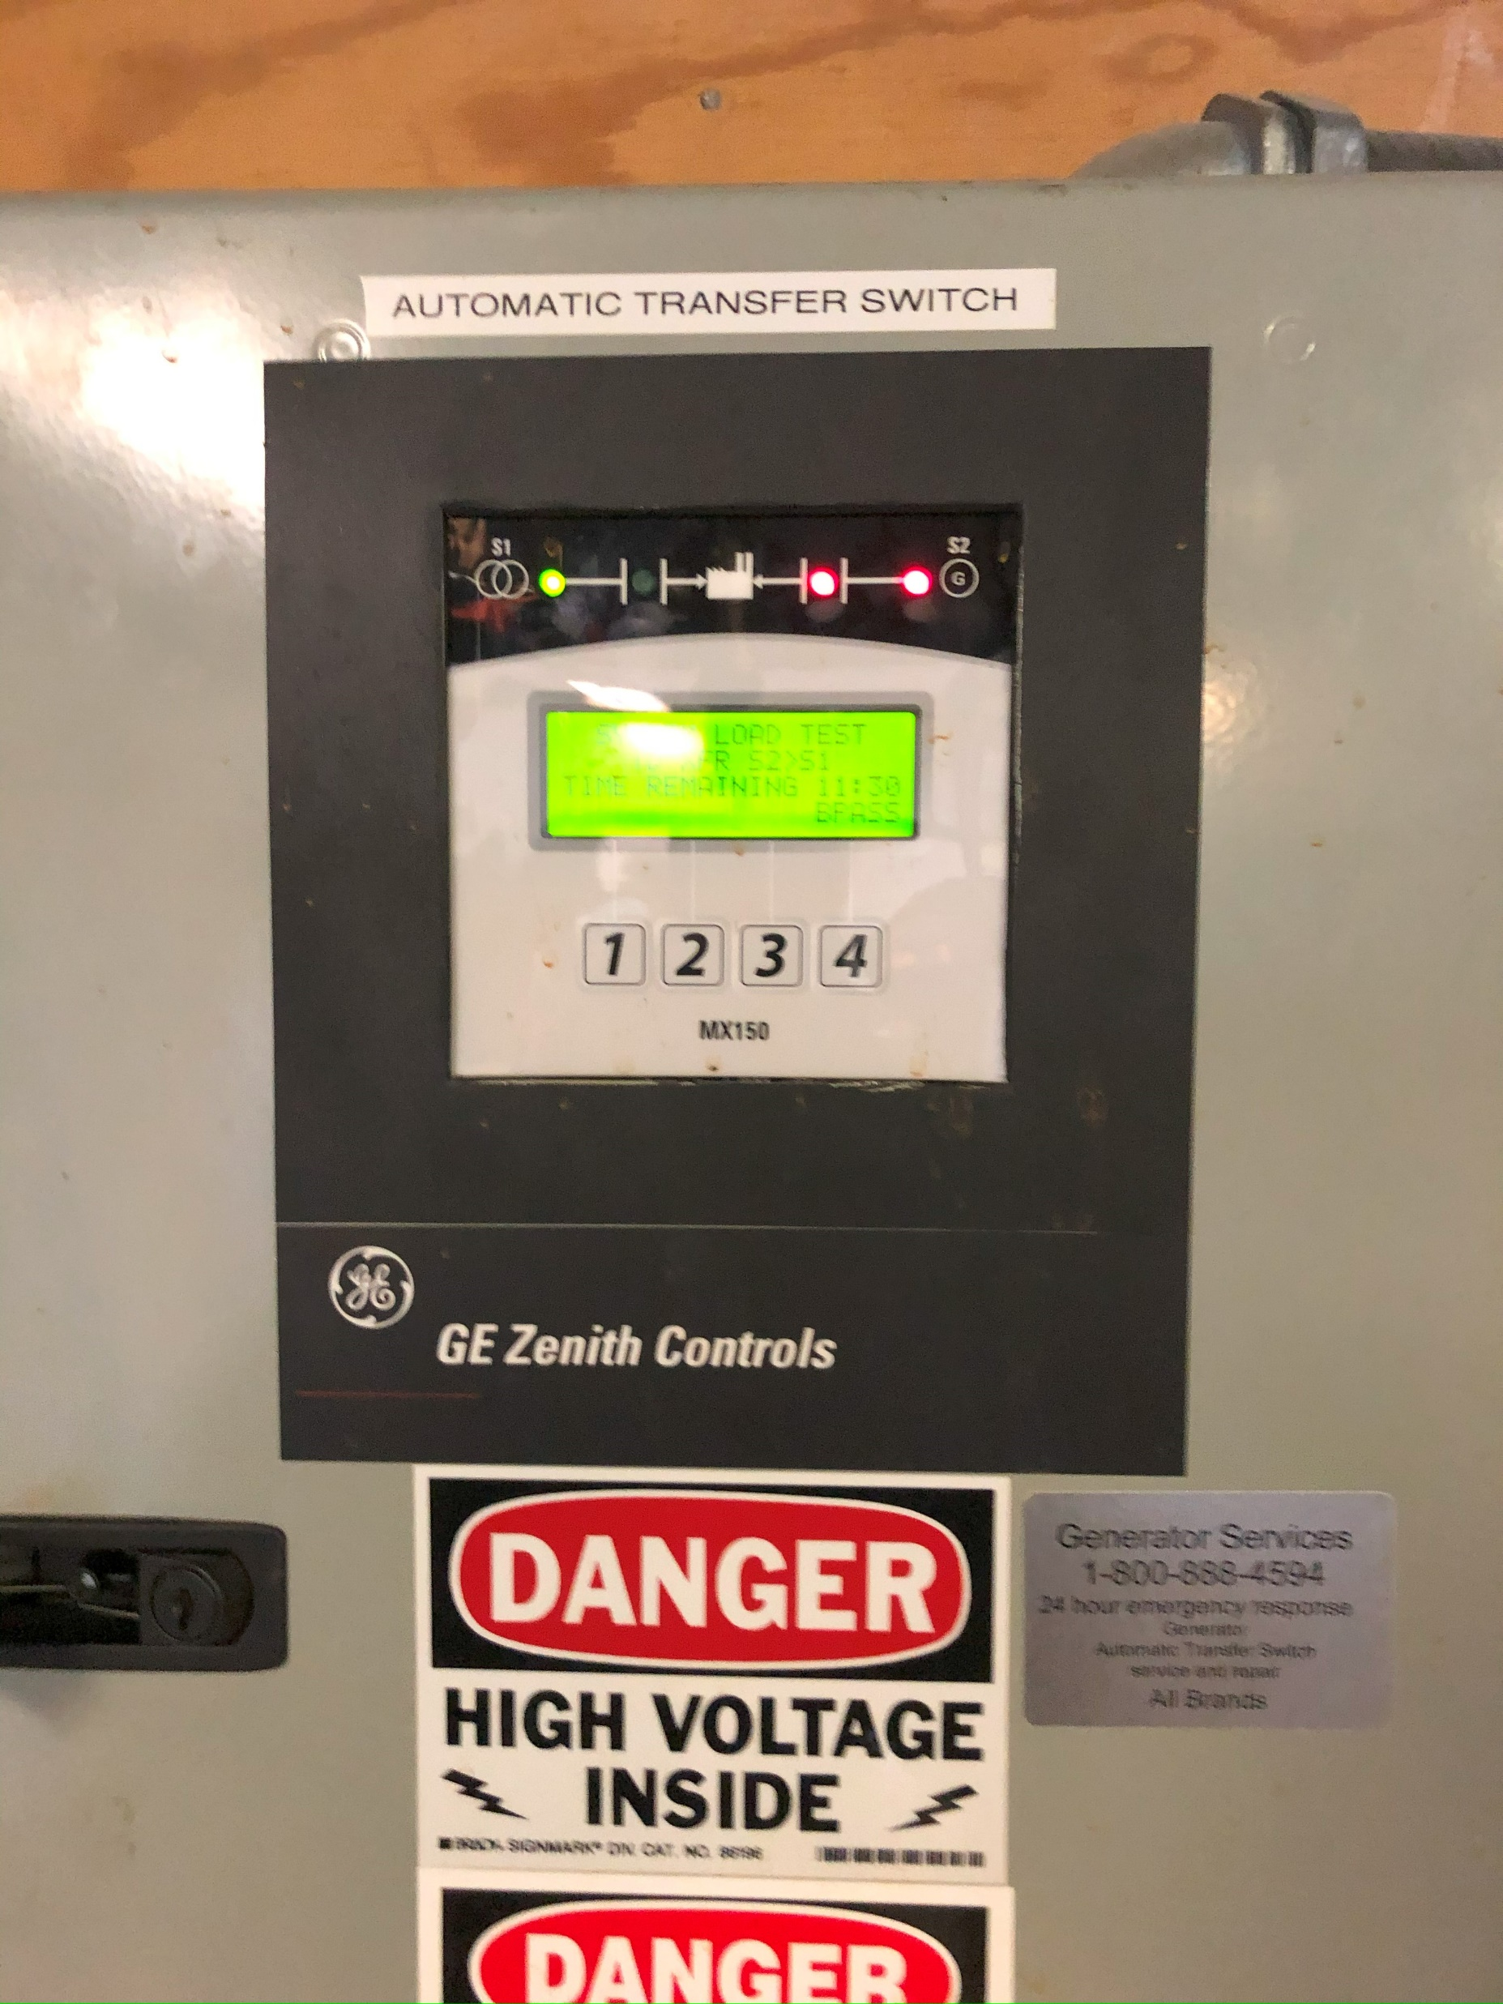

Slide 26
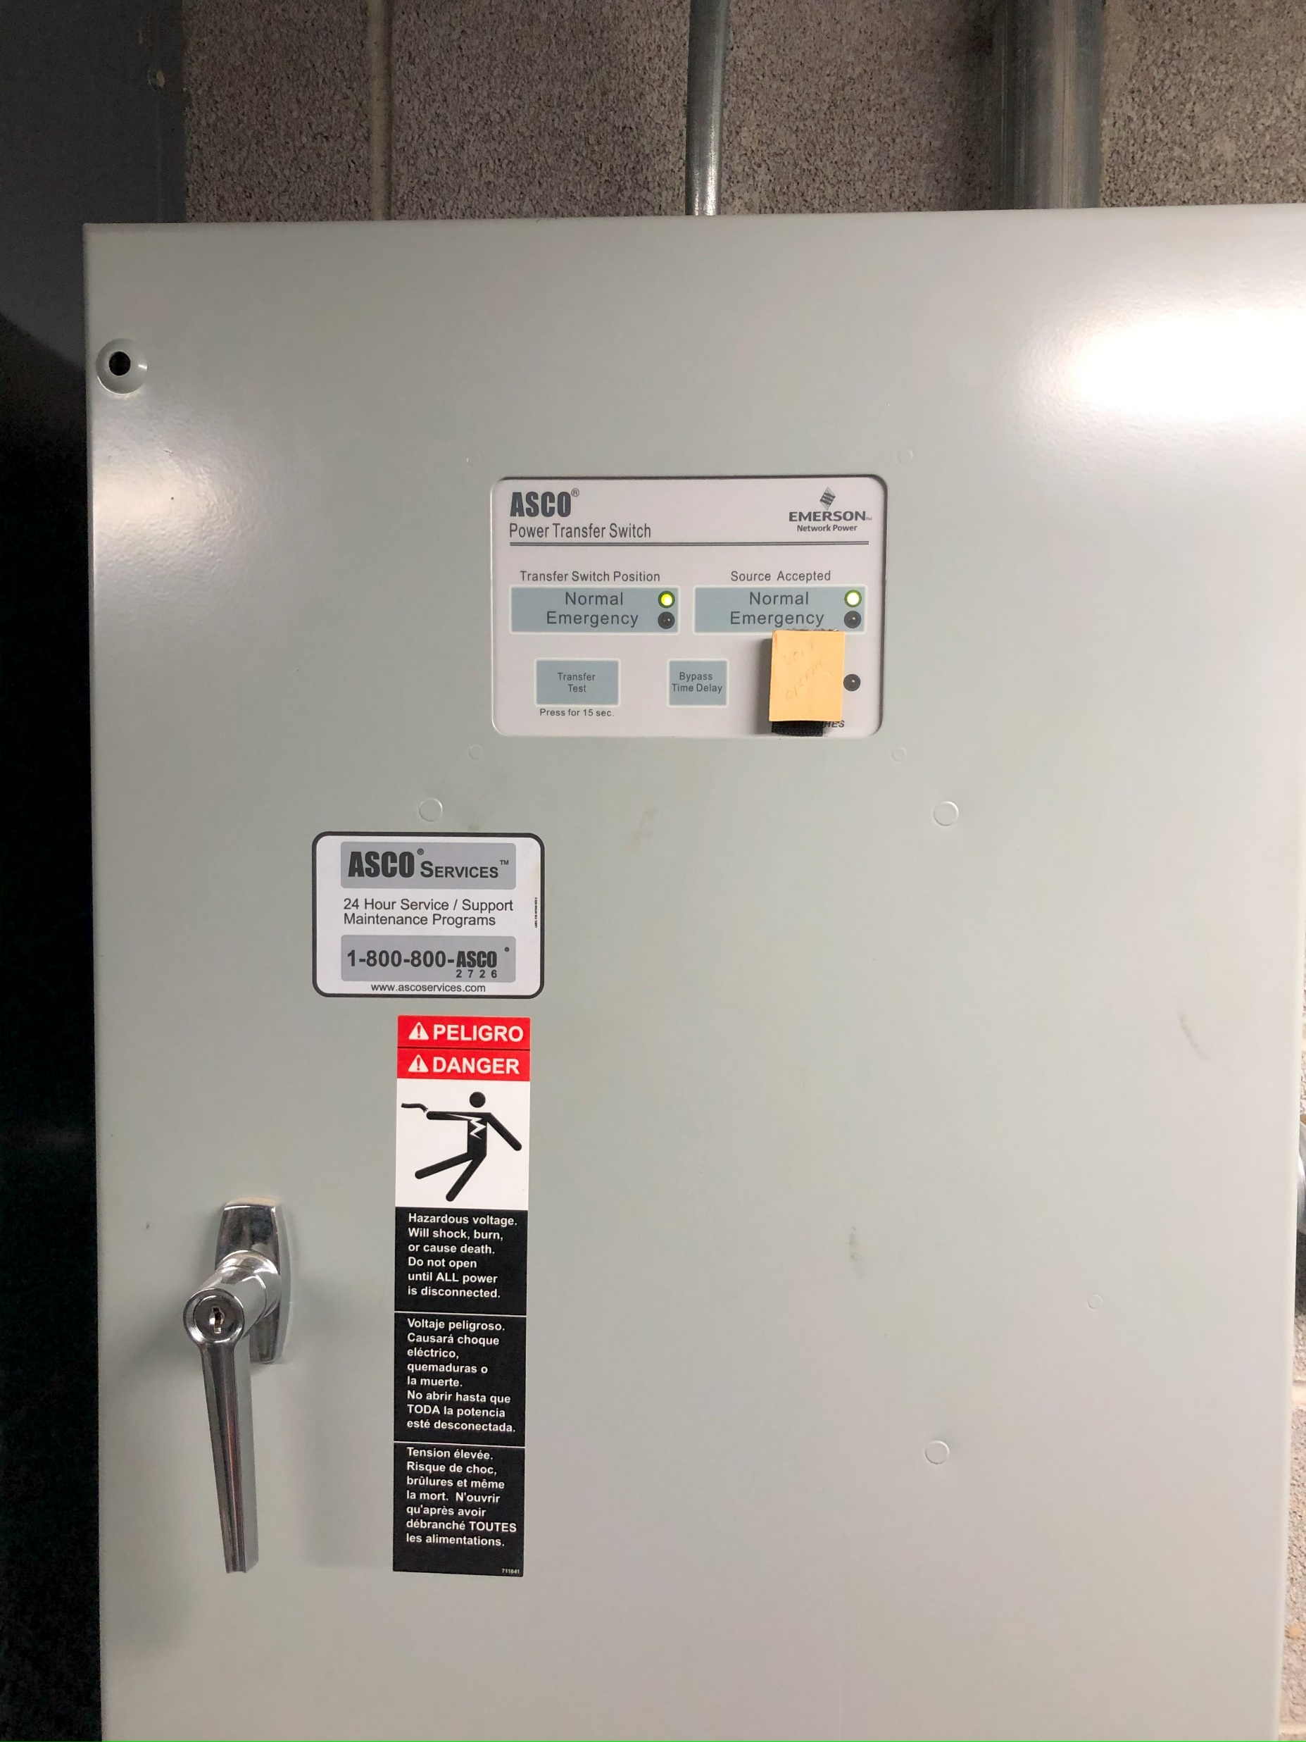

Slide 27
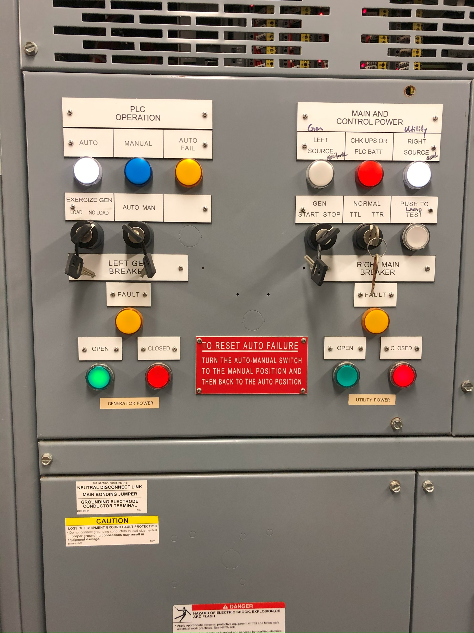

Slide 28
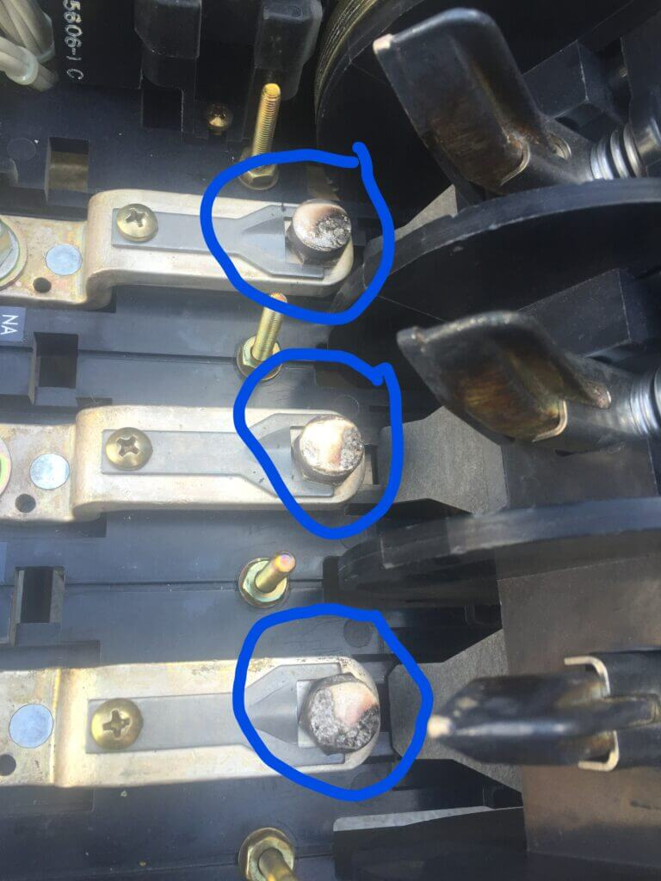

Slide 29
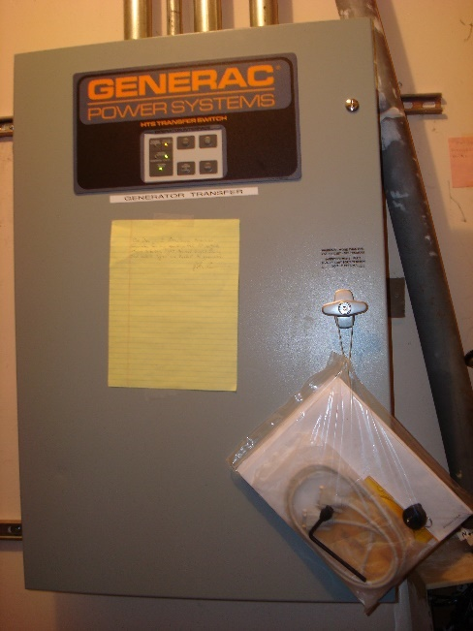
HTS requires battery replacement in 3 years
TX requires battery replacement annually

Slide 30
Traditional 2-wire start method
The generator start signal design illustrated here has been used by All transfer switch manufacturers including Generac for decades because of high reliability and universal acceptance.
Utility normal as illustrated—no start signal yet since normal electrical power is present
Start contact open
Battery voltage travels from the generator control panel to the automatic transfer switch then stops. The generator control panel waits for the transfer switch to sense utility power failure and close the start contact.
Generator Control Panel
Automatic Transfer Switch

Slide 31
Utility Failed—start signal is sent from the automatic transfer switch back to the generator control panel to initiate a start.
Start contact closed
Battery voltage travels from the generator control panel to the automatic transfer switch and then back to the generator control panel.
Generator Control Panel
Automatic Transfer Switch

Slide 32
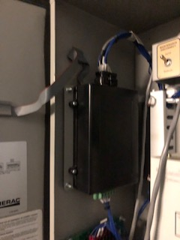
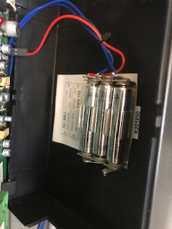
Generac Modbus RTU start system used by the Generac HTS switch
Generac HTS transfer switch controller location
The three AAA batteries are located inside the controller box

Slide 33
Paragraph 4.5, Batteries, on page 15 of the Owner’s Manual OF5574 states “…Replace with Panasonic catalog no. HHR75AAA or equivalent every three (3) years.

Slide 34
Page 23 of the Generac TX Owner’s manual, A0000347502, says to replace the battery annually.

Slide 35
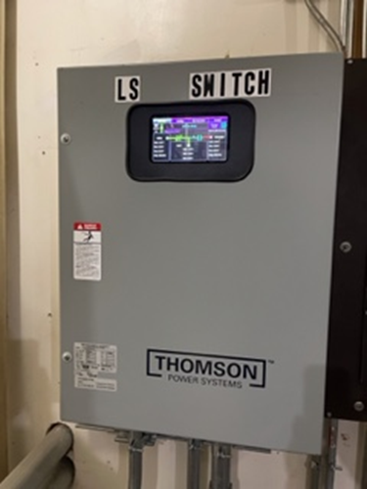

Slide 36
This is an email I received from Thompson
Hi Paul,
the TSC900 is no longer an actively sold product and there will likely be no further firmware updates.
We only notify customers if they call us with an issue, at which time we recommend updating the firmware
Thanks,
From: paul generatorservices.com <paul@generatorservices.com>
Sent: Tuesday, June 3, 2025 7:36 AM
To: Sidhu, Harsimran <Harsimran.Sidhu@regalrexnord.com>
Subject: Re: SR-7316 | 2779306 ORDER NO.

Slide 37
Automatic transfer switches transition
Open
Closed
By-pass Isolation
Breaker as opposed to contactor type

Slide 38
3. Check the coolant heater
Use an infrared gun and check the temperature on the engine block.
It should always be above 60 degrees F

